Slide 1
Deep Dive into Office 365 APIs for OneDrive for Business

Slide 2

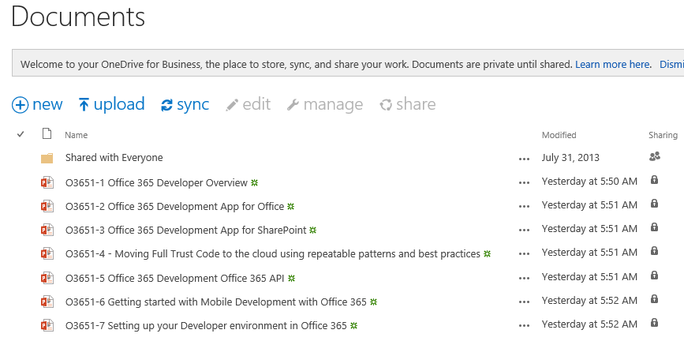
OneDrive for Business
A personal library for storing and organizing your work documents
Notes:
OneDrive for Business is a personal library intended for storing and organizing your work documents. As an integral part of Office 365 or SharePoint Server 2013, OneDrive for Business lets you work within the context of your organization, with features such as direct access to your organization’s address book.
Note OneDrive for Business is different from OneDrive, which is intended for personal storage separate from your workplace. OneDrive for Business is also different from your team site, which is intended for storing team or project-related documents.

Slide 3
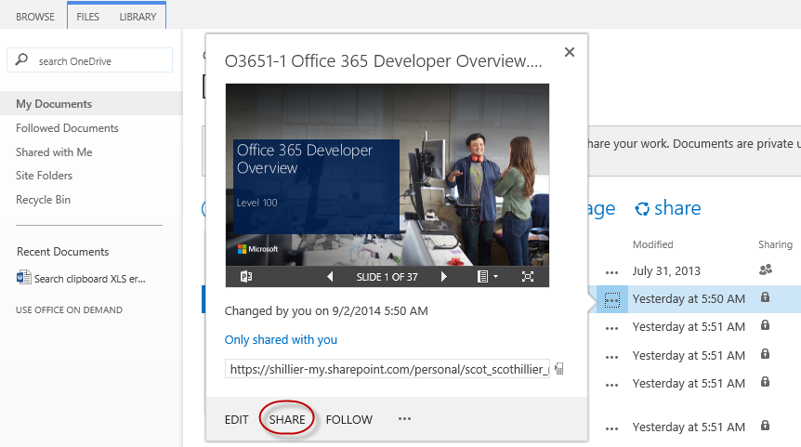
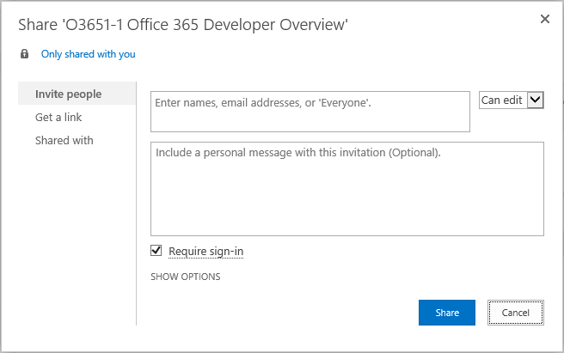
OneDrive for Business Sharing
Notes:
The documents and folders you store in OneDrive for Business are private until you decide to share them. When you share documents and folders, you can decide whether to let people edit them, or just view them. You can also share documents or folders in a site library.
Note If you’re using Office 365, you may be able share documents with external users (people not on your network) by inviting them as “Guests,” or by creating and posting guest links

Slide 4
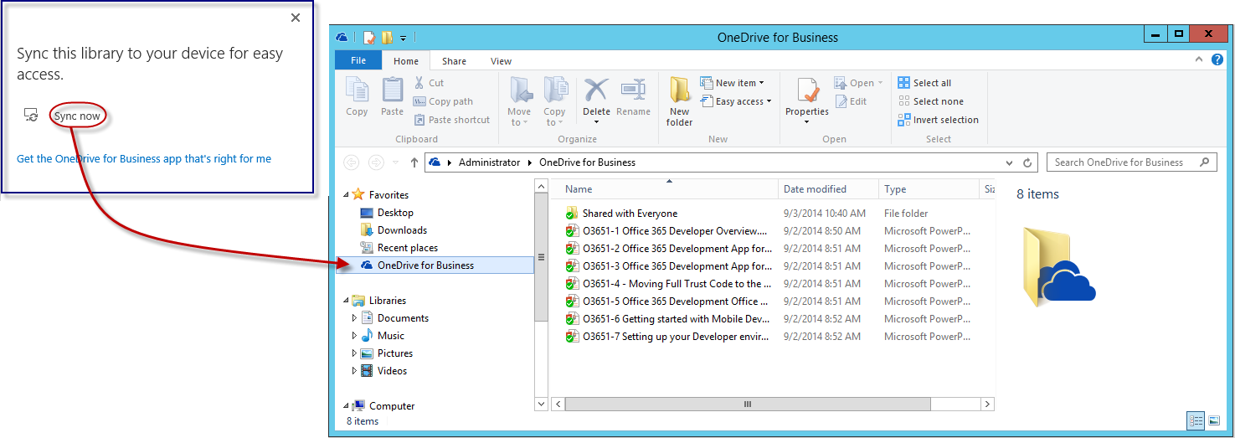
OneDrive for Business Sync
Notes:
The OneDrive for Business sync app lets you synchronize your OneDrive for Business library or other SharePoint site libraries to your local computer. This sync app is available with Office 2013 or with Office 365 subscriptions that include Office 2013 applications. If you don’t have Office 2013, a free download of the OneDrive for Business sync app is also available.
To sync OneDrive for Business, sign in to Office 365 or SharePoint, select OneDrive at the top of the page, and then click Sync.
You’ll find your synchronized files in your File Explorer, under Favorites. If you’re syncing an Office 365 OneDrive for Business library, your synchronized files appear in the OneDrive@<organization> folder. Work on them locally if you like and your changes will be synchronized automatically with your OneDrive for Business library when you’re online.

Slide 5
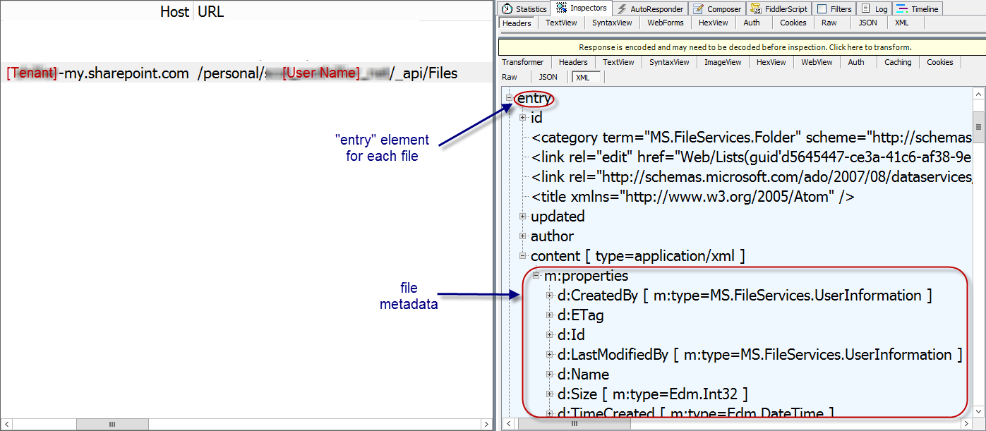
The Files API
https://[site]/_api/Files
Notes:
_api/Files always targets the “Documents” library in a SharePoint site
For personal sites, this is the OneDrive for Business library

Slide 6
File Operations with REST

Slide 7
OneDrive for Business Files REST API
Get the metadata for all files in OneDrive
GET http://<onedrive>/_api/Files
Get the metadata for a folder in OneDrive
GET http://<onedrive>/_api/Files('folder')
Get the metadata for the children of a folder in OneDrive
GET http://<onedrive>/_api/Files('folder')/Children
Get the metadata for a single file in OneDrive
GET http://<onedrive>/_api/Files('folder/filename.docx')
Download a single file from OneDrive
GET http://<onedrive>/_api/Files('folder/filename.docx')/download

Slide 8
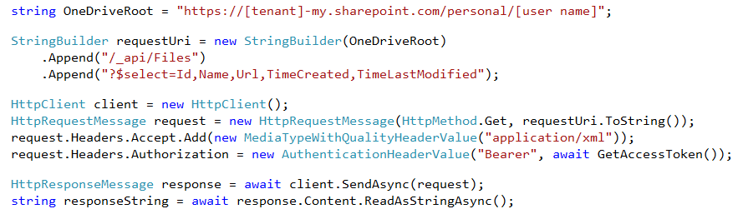
Reading File Metadata
GET Files endpoint
Paging is accomplished post-query using LINQ
Notes:
No support for $skip and $orderby so paging is post-query
Note that the OneDrive URI is hard-coded just for clarity. Normally, you would get this from the discover service.

Slide 9
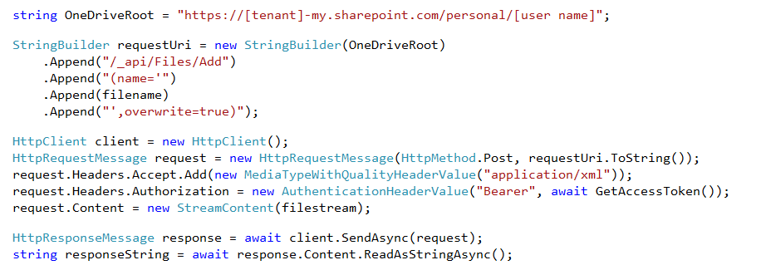
Uploading a new File
POST to Add endpoint
Provide a file name and the file stream
Notes:
Note that the OneDrive URI is hard-coded just for clarity. Normally, you would get this from the discover service.

Slide 10
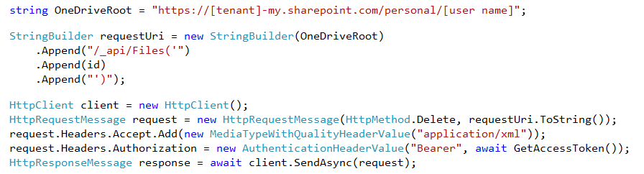
Deleting a File
DELETE the target file ID
Notes:
Note that the OneDrive URI is hard-coded just for clarity. Normally, you would get this from the discover service.

Slide 11
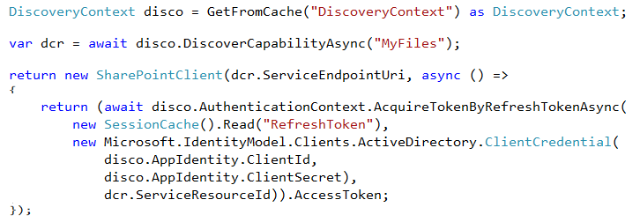
SharePointClient class
Discovery Service discovers “MyFiles” capability
Returns tenant and user-specific URL for user’s OneDrive for Business
SharePointClient.Files abstracts Files API
Notes:
The discovery service discovers the “MyFiles” capability, which will always try to access the OneDrive for Business library

Slide 12
Reading File Metadata
Read Files collection
Can also read an individual Folder
Notes:
No support for $skip and $orderby so paging is post-query

Slide 13
Uploading a new File
Use AddAsync method
Provide a file name and the file stream

Slide 14
Deleting a File
Get the target file using GetByAsync method
Delete using DeleteAsync method

Slide 15
demo
File operations with the SharePointClient

Slide 16

© 2014 Microsoft Corporation. All rights reserved. Microsoft, Windows, and other product names are or may be registered trademarks and/or trademarks in the U.S. and/or other countries.
The information herein is for informational purposes only and represents the current view of Microsoft Corporation as of the date of this presentation. Because Microsoft must respond to changing market conditions, it should not be interpreted to be a commitment on the part of Microsoft, and Microsoft cannot guarantee the accuracy of any information provided after the date of this presentation. MICROSOFT MAKES NO WARRANTIES, EXPRESS, IMPLIED OR STATUTORY, AS TO THE INFORMATION IN THIS PRESENTATION.

